Slide 1
RMI
The RMI (Remote Method Invocation) is an API that provides a mechanism to create distributed application in java..
It is a mechanism that allows an object residing in one system (JVM) to access/invoke an object running on another JVM.
it provides remote communication between Java programs. It is provided in the package java.rmi
The RMI provides remote communication between the applications using two objects stub and skeleton.

Slide 2
Contd…
In an RMI application, we write two programs, a server program (resides on the server) and a client program (resides on the client).
Inside the server program, a remote object is created and reference of that object is made available for the client (using the registry).
The client program requests the remote objects on the server and tries to invoke its methods.

Slide 3
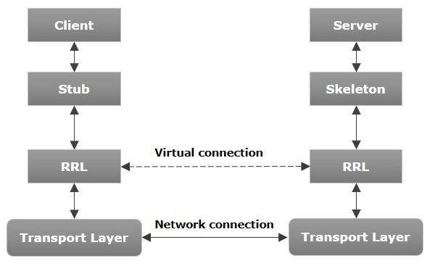
Architecture of an RMI application.

Slide 4
Stub
The stub is an object, acts as a gateway for the client side.
All the outgoing requests are routed through it.
It resides at the client side and represents the remote object. When the caller invokes method on the stub object,
It does the following tasks:
It initiates a connection with remote Virtual Machine (JVM),
It writes and transmits (marshals) the parameters to the remote Virtual Machine (JVM),
It waits for the result
It reads (unmarshals) the return value or exception, and
It finally, returns the value to the caller.

Slide 5
Skeleton
The skeleton is an object, acts as a gateway for the server side object.
All the incoming requests are routed through it. When the skeleton receives the incoming request,
It does the following tasks:
It reads the parameter for the remote method
It invokes the method on the actual remote object, and
It writes and transmits (marshals) the result to the caller.

Slide 6
Contd…
If any application performs these tasks, it can be distributed application.
The application need to locate the remote method
It need to provide the communication with the remote objects, and
The application need to load the class definitions for the objects.

Slide 7
Remote Interfaces
Remote objects are objects that implement a special remote interface that specifies which of the object’s methods can be invoked remotely.
The remote interface must extend the java.rmi.Remote interface.
remote object will implement its remote interface; as will the stub object that is automatically generated for it.
we should then refer to the remote object as an instance of the remote interface—not as an instance of its actual class.
Because both the real object and stub implement the remote interface, they are equivalent as far as we are concerned (for method invocation)

Slide 8
Contd…
All methods in the remote interface must declare that they can throw the exception java.rmi.RemoteException .
This exception (actually, one of many subclasses to RemoteException) is thrown when any kind of networking error happens:
for example, the server could crash, the network could fail, or you could be requesting an object that for some reason isn’t available.

Slide 9
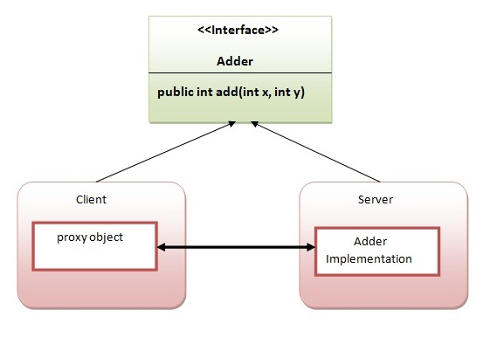
RMI Example

Slide 10
create the remote interface
Creating the remote interface, extend the Remote interface and declare the RemoteException with all the methods of the remote interface.
There is only one method named add() and it declares RemoteException.
import java.rmi.*;
public interface Adder extends Remote{
public int add(int x,int y)throws RemoteException;
}

Slide 11
2) Provide The Implementation Of The Remote Interface
Now provide the implementation of the remote interface.
For providing the implementation of the Remote interface,
We need to
Either extend the UnicastRemoteObject class,
or use the exportObject() method of the UnicastRemoteObject class
In case, you extend the UnicastRemoteObject class, you must define a constructor that declares RemoteException.

Slide 12
import java.rmi.*;
import java.rmi.server.*;
public class AdderRemote extends UnicastRemoteObject implements Adder{
AdderRemote()throws RemoteException{
super();
}
public int add(int x,int y){return x+y;}
}

Slide 13
3) Create The Stub And Skeleton Objects Using The Rmic Tool.
Next step is to create stub and skeleton objects using the rmi compiler.
The rmic tool invokes the RMI compiler and creates stub and skeleton objects.
rmic AdderRemote

Slide 14
4) Start the registry service by the rmiregistry tool
Now start the registry service by using the rmiregistry tool.
If you don't specify the port number, it uses a default port number. In this example, we are using the port number 5000.
rmiregistry 5000

Slide 15
5) Create and run the server application
Now rmi services need to be hosted in a server process.
The Naming class provides methods to get and store the remote object.
The Naming class provides 5 methods.

Slide 16
java.rmi.Remote lookup(java.lang.String) | It returns the reference of the remote object.
void bind(java.lang.String, java.rmi.Remote) | It binds the remote object with the given name.
void unbind(java.lang.String) | It destroys the remote object which is bound with the given name.
void rebind(java.lang.String, java.rmi.Remote) | It binds the remote object to the new name.
java.lang.String[] list(java.lang.String) | It returns an array of the names of the remote objects bound in the registry.

Slide 17
In this example, we are binding the remote object by the name sonoo.
import java.rmi.*;
import java.rmi.registry.*;
public class MyServer{
public static void main(String args[]){
Try
{
Adder stub=new AdderRemote();
Naming.rebind("rmi://localhost:5000/sonoo",stub);
}
catch(Exception e)
{
System.out.println(e);
}
} }

Slide 18
6) Create and run the client application
At the client we are getting the stub object by the lookup() method of the Naming class and invoking the method on this object.
In this example, we are running the server and client applications, in the same machine so we are using localhost.
If you want to access the remote object from another machine, change the localhost to the host name (or IP address) where the remote object is located.

Slide 19
import java.rmi.*;
public class MyClient{
public static void main(String args[]){
try{
Adder stub=(Adder)Naming.lookup("rmi://localhost:5000/sonoo");
System.out.println(stub.add(34,4));
}
catch(Exception e){}
}
}

Slide 20
For running this rmi example,
1) compile all the java files
javac *.java
2)create stub and skeleton object by rmic tool
rmic AdderRemote
3)start rmi registry in one command prompt
rmiregistry 5000
4)start the server in another command prompt
java MyServer
5)start the client application in another command prompt
java MyClient

Slide 21
Marshalling And Unmarshalling
Whenever a client invokes a method that accepts parameters on a remote object, the parameters are bundled into a message before being sent over the network.
These parameters may be of primitive type or objects.
In case of primitive type, the parameters are put together and a header is attached to it.
In case the parameters are objects, then they are serialized.
This process is known as marshalling.
At the server side, the packed parameters are unbundled and then the required method is invoked.
This process is known as unmarshalling.

Slide 22
RMI Object Activation
RMI is the ability to create remote objects that are persistent.
They can save their state and be reactivated when a request from a client arrives.
This is an important feature for large systems with remote objects that must remain accessible across long periods of time.
RMI activation effectively allows a remote object to be stored away in a database, automatically be reincarnated when it is needed.
RMI activation is not particularly easy to use and would not have benefited us in any of our simple examples; we won’t delve into it here.
Much of the functionality of activatable objects can be achieved by using factories of shorter-lived objects that know how to retrieve some state from a database (or other location).
The primary users of RMI activation may be systems like Enterprise JavaBeans, which need a generalized mechanism to save remotely accessible objects and revive them at later times.

Slide 23
RMI Registry
It is a namespace on which all server objects are placed.
Each time the server creates an object, it registers this object with the RMIregistry (using bind() or reBind() methods).
These are registered using a unique name known as bind name.
To invoke a remote object, the client needs a reference of that object.
At that time, the client fetches the object from the registry using its bind name (using lookup() method).

Slide 24
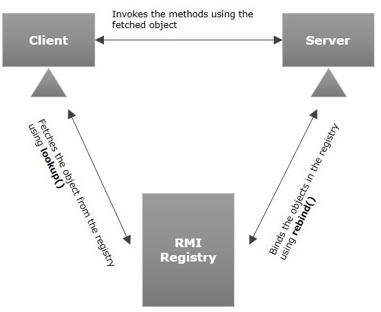

Slide 25
RMI | CORBA
RMI is a Java-specific technology. | It has implementation for many languages.
It uses Java interface for implementation. | It uses Interface Definition Language (IDL) to separate interface from implementation.
RMI objects are garbage collected automatically. | CORBA objects are not garbage collected because it is language independent and some languages like C++ does not support garbage collection.
RMI programs can download new classes from remote JVM’s. | CORBA does not support this code sharing mechanism.
RMI passes objects by remote reference or by value. | CORBA passes objects by reference.
Java RMI is a server-centric model. | CORBA is a peer-to-peer system.
RMI uses the Java Remote Method Protocol as its underlying remoting protocol. | It use Internet Inter- ORB Protocol as its underlying remoting protocol.
The responsibility of locating an object implementation falls on JVM. | The responsibility of locating an object implementation falls on Object Adapter either Basic Object Adapter or Portable Object Adapter.

